Slide 1

E BANKING
A Complete Banking
On your Hands!!

Slide 2

ABSTRACT
This project is a web-based application specially for banking sector.
This project is to develop a perfect database for bank management system.
This project has been developed with a clear manner of database relating to all essentials, which is not possible with the manuals work, which are overcome by this database.
It can keep the information of Account type, account opening form, Deposit, Withdrawal, and Searching the transaction, Transaction report.
This project is developed using MySQL.
Hence it will provide the complete database for the current management system.

Slide 3

INTRODUCTION
Nowadays, banking is one of the major fields but this field haven’t completely ruled by internet due to various reasons like user-interface, security, reliability, convenient and also in data-handling aspect.
To solve these issues, advanced technology is used to handle all these issues.
“Online Banking Management System” works well with security, easy user-interface and convenience.
The main reason behind undertaking this project is to handle the data in a wise manner and to bring out easy user-interface site which paves way for more account users to use internet facility more.
And it brings more digital transactions with ease mode of interface.

Slide 4

OBJECTIVES
Officers are only the one to create a registered account for the users.
Easy way of accessing the website with login portal.
It makes easier to update the user credentials and also to view.
This site makes the user to feel the easy user-interface mode with all delight features.
Only registered account numbers are used for transactions.
The limit of online transactions and times of transaction is also displayed in the banking website.

Slide 5

TECHNIQUES USED
E BANKING website is laid down with the following properties:
Table properties of html.
Form properties of html.
Navigation properties are used for styling purpose.
Responsive carousel using Bootstrap.
Responsive pages for multiple devices using Bootstrap.
Each and every page is connected to the MySQL database.
Each and every login and logout is maintained by SESSION property in PHP.
CRUD application is also used in PHP language.

Slide 6

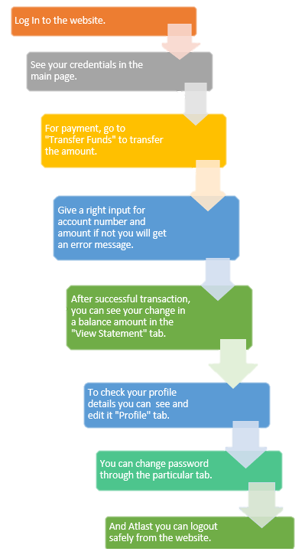
FLOW CHART
The Process of site is easily described in the flow chart.

Slide 7

SOFTWARE & HARDWARE REQUIREMENTS
Internet explorer of versions 6
Firefox browser of version 3.5
Opera browser of version 2
Chrome version 8 or more

Slide 8

ADVANTAGES
Banking on our Hands.
Easy user interface.
Easier way of amount transaction only for the registered account numbers.
Clear Statement of all transaction records.
Instant transactions
Quick data retrieval

Slide 9
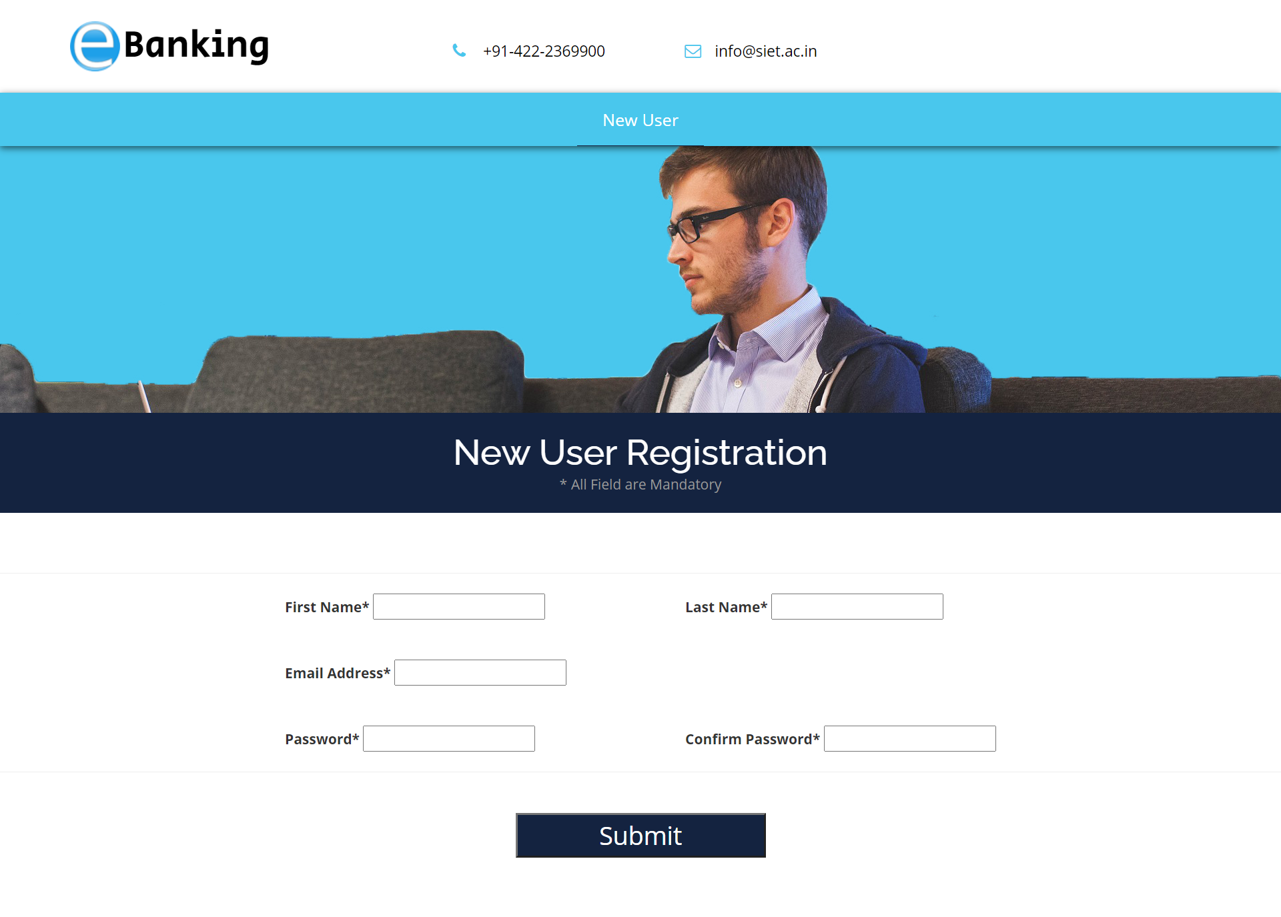
Registration PAGE 1
SOURCE CODE :
view-source:http://localhost/banking%20web/register.php

Slide 10
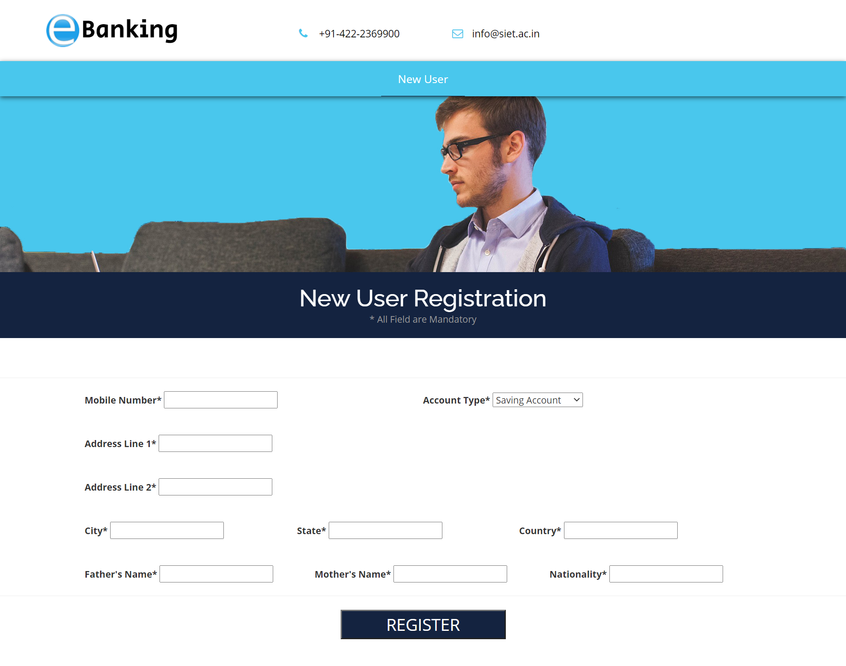
Registration PAGE 2
SOURCE CODE :
view-source:http://localhost/banking%20web/register2.php

Slide 11
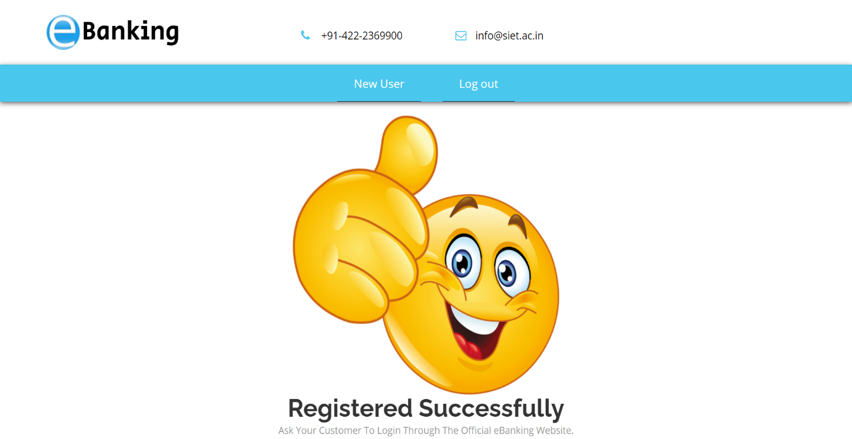
REGISTRATION SUCCESS PAGE
SOURCE CODE :
view-source:http://localhost/banking%20web/successregister.html

Slide 12
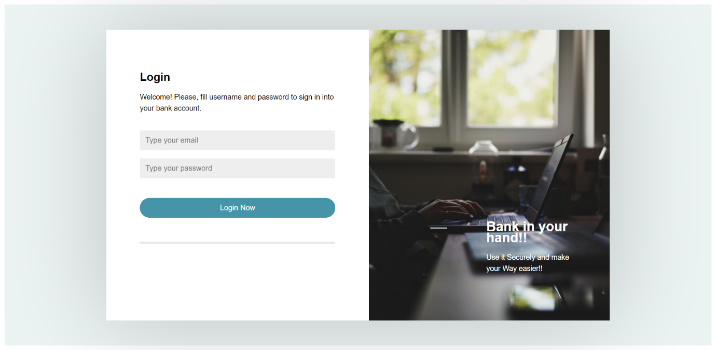
LOGIN PAGE
SOURCE CODE :
view-source:localhost/banking%20web/login.html

Slide 13
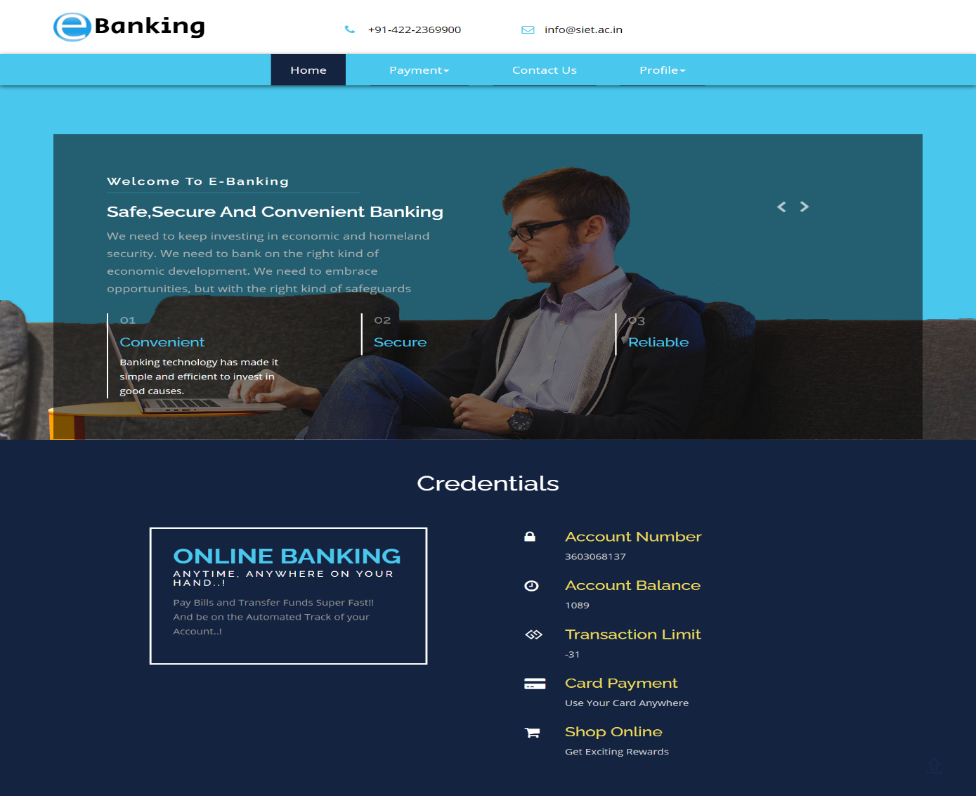
HOME PAGE
SOURCE CODE :
view-source:localhost/banking%20web/index.php

Slide 14
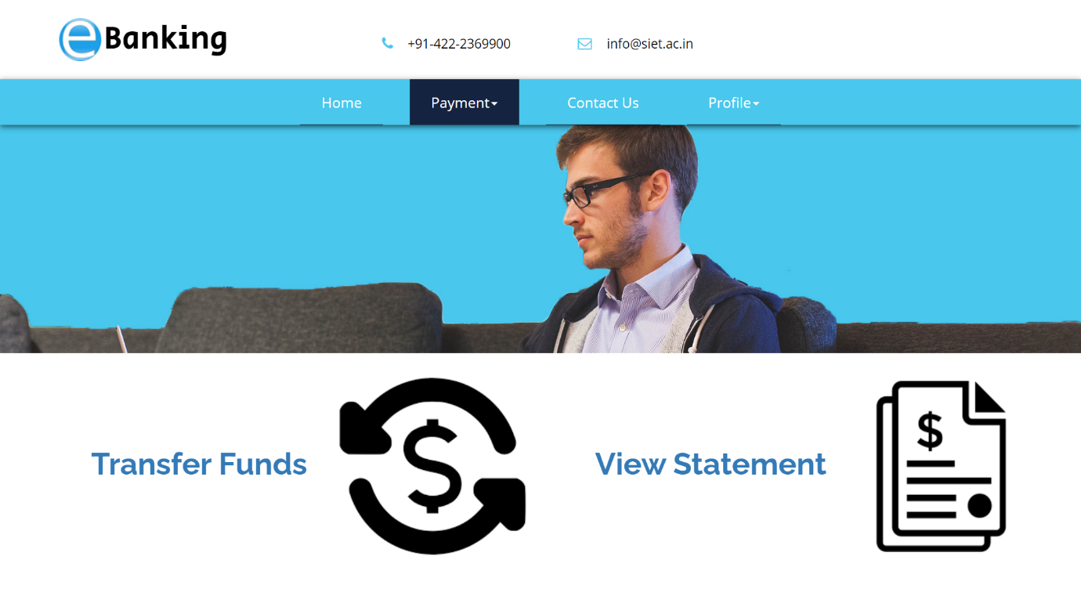
payment PAGE
SOURCE CODE :
view-source:localhost/banking%20web/payment.php

Slide 15
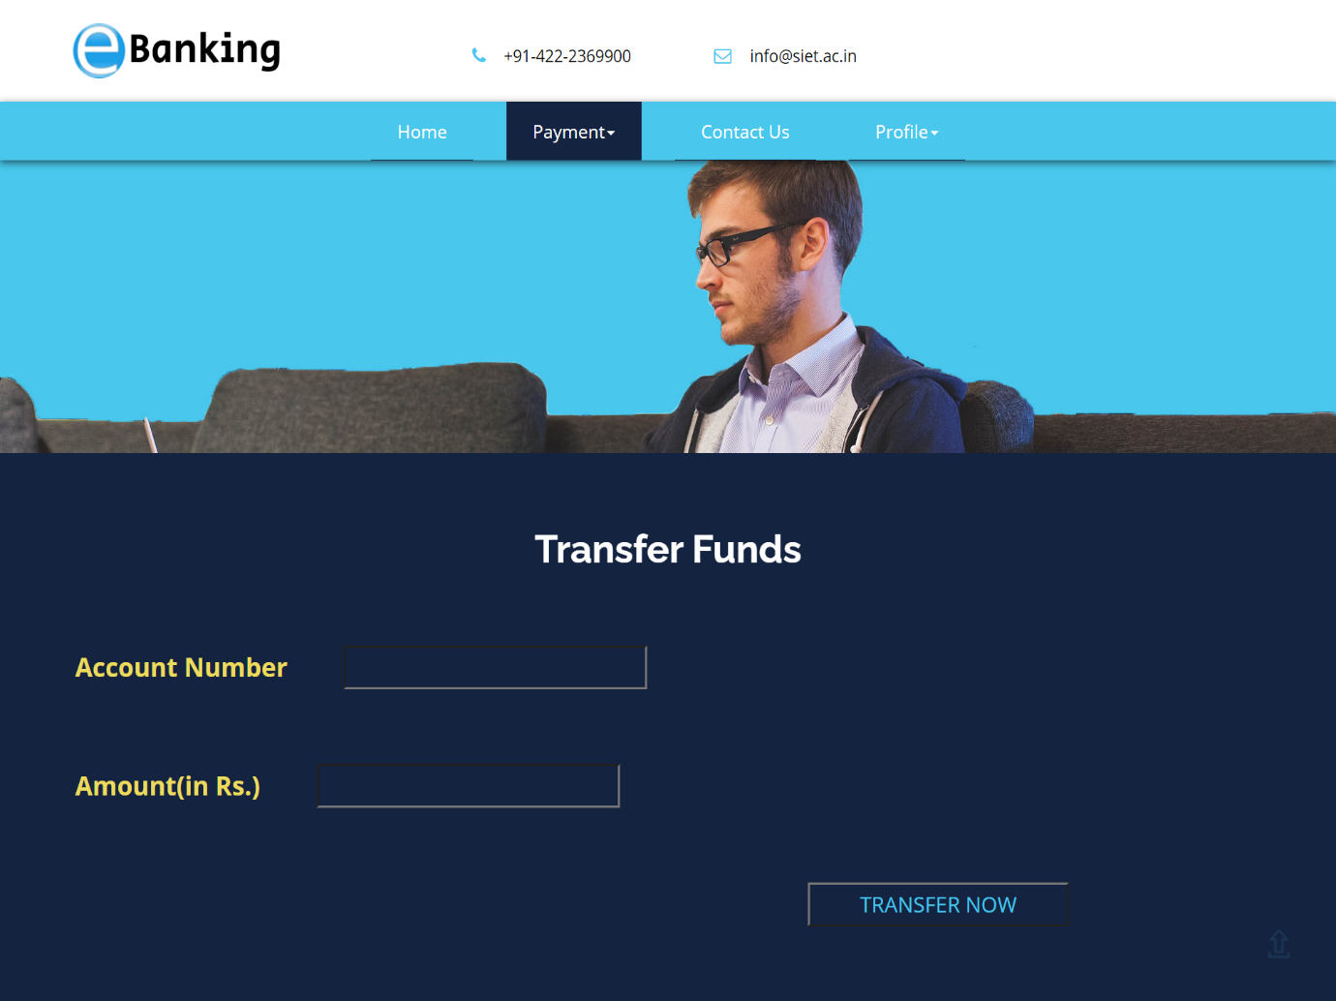
Transfer funds PAGE
SOURCE CODE :
view-source:http://localhost/banking%20web/Transfer_funds.php

Slide 16
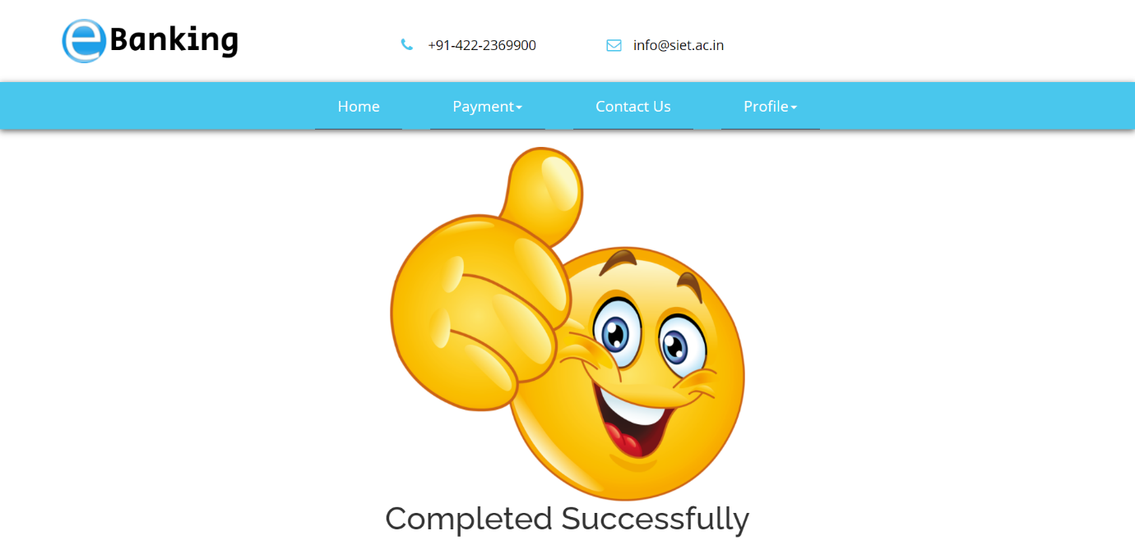
payment SUCCESS PAGE
SOURCE CODE :
view-source:http://localhost/banking%20web/success.html

Slide 17
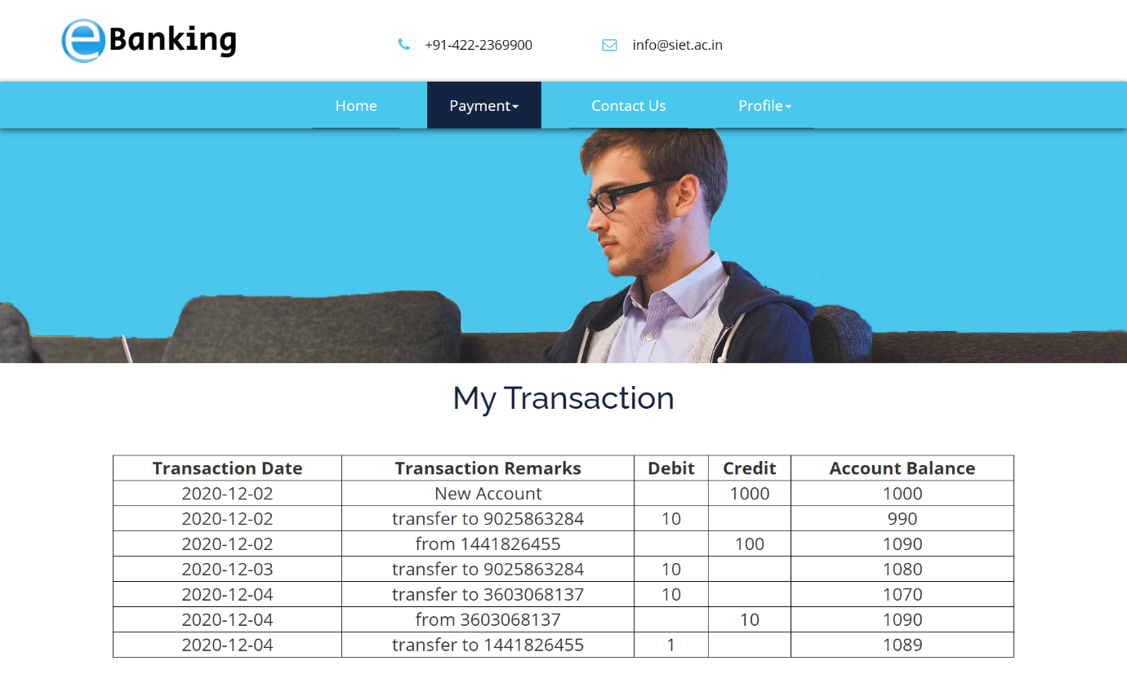
View statement PAGE
SOURCE CODE :
view-source:http://localhost/banking%20web/Statement.php

Slide 18
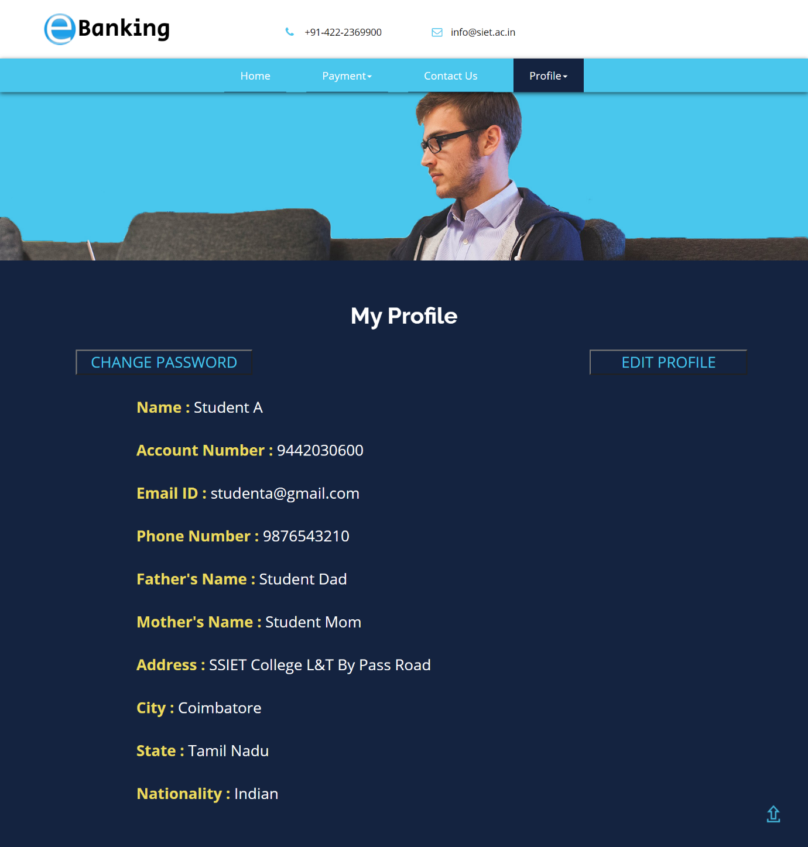
profile PAGE
SOURCE CODE :
view-source:http://localhost/banking%20web/profile.php

Slide 19
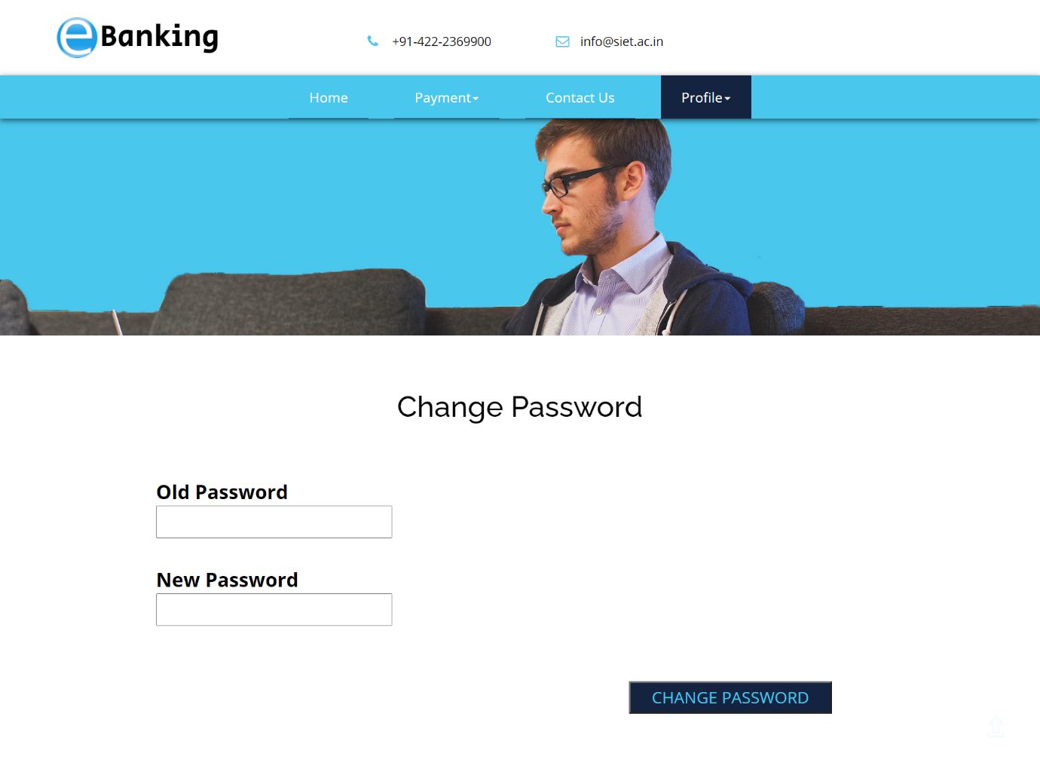
Change password PAGE
SOURCE CODE :
view-source:http://localhost/banking%20web/password.php

Slide 20
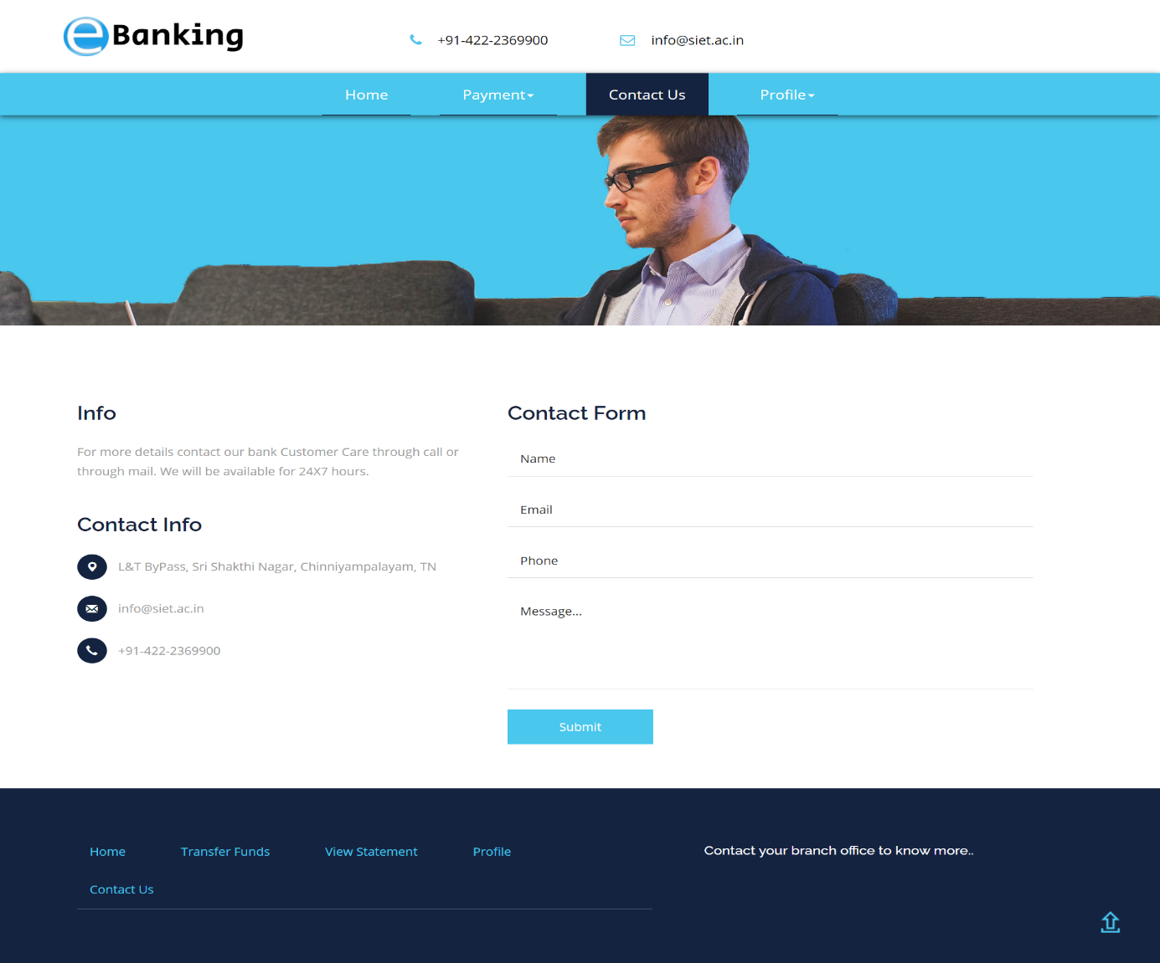
Contact us PAGE
SOURCE CODE :
view-source:http://localhost/banking%20web/contact.php

Slide 21
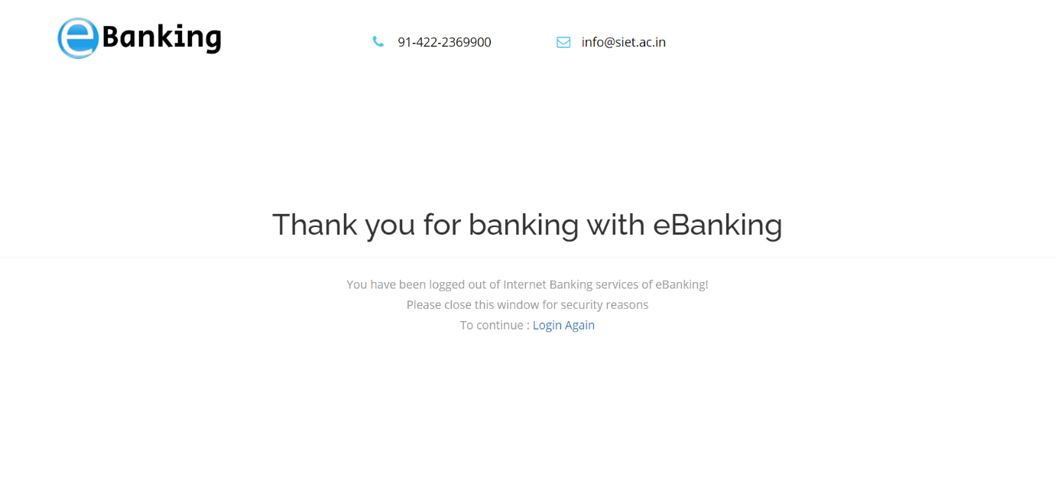
logout PAGE
SOURCE CODE :
view-source:http://localhost/banking%20web/logout.php

Slide 22

CONCLUSION
The banking will be done until the money is in usage.
Thus, this online banking management website is successfully created with absolute backend connectivity.
A bank account is not only about saving money, it’s also about managing money.
All data transactions are updated regularly with the website.
Hence, the user will be updated with recent activity.
And, this website is secured with password and thus, those data aren’t leaked or exposed.
Such kind of secured, convenient, reliability of the site will bring more users to use it likely.
Banking sites must be used more and more to digitalize the banks.

Slide 23

FUTURE ENHANCEMENT
Hashing up the password, hence the login portal will be much stronger than now.
Updating the website with loan section.
Adding up with the beneficiary account on the website.
Retrieval of statement on selected date.
Creating a section for the using the credit points and also for shopping site.

Slide 24

References
Online banking practices :
https://en.wikipedia.org/wiki/Online_banking
Online banking rules :
https://financialservices.gov.in/act-rule/Banking/Banking-Rules
Online banking services :
https://cleartax.in/s/net-banking

Slide 25

THANK YOU..!

